Slide 1
Advanced Counting Techniques
Chapter 8

Slide 2
Applications of Recurrence Relations
Section 8.1

Slide 3
Video 67: Counting with Recurrence Relations
Counting with Recurrence Relations
Counting Bitstrings
The Tower of Hanoi
Counting Arrangments of Parantheses

Slide 4
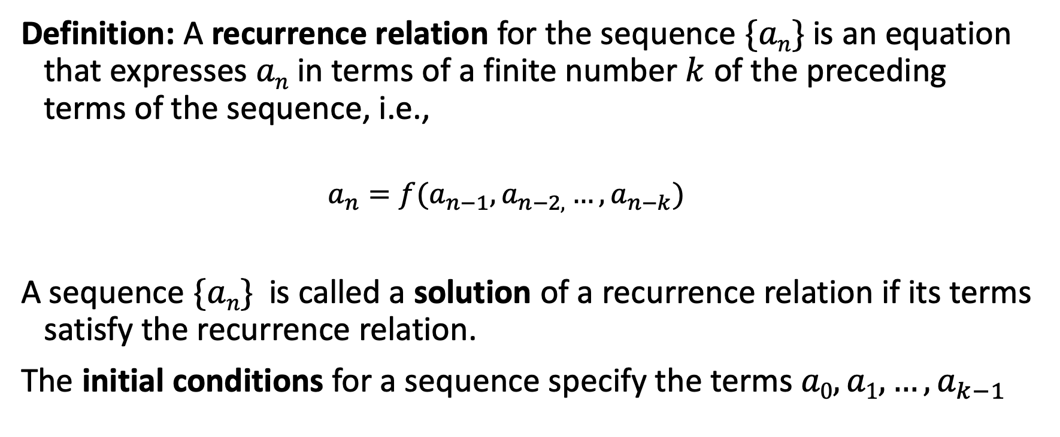
Recurrence Relations
Definition: A recurrence relation for the sequence $\{an\}$is an equation that expresses $an$ in terms of a finite number $k$ of the preceding terms of the sequence, i.e.,
$$a_{n}=f(a_{n−1},a_{n−2,}…,a_{n−k})$$
A sequence $\{an\}$is called a solution of a recurrence relation if its terms satisfy the recurrence relation.
The initial conditions for a sequence specify the terms $a0, a1, …, a_{k−1}$

Slide 5
Fibonacci Sequence
Definition: The Fibonacci sequence f₀ , f₁ , f₂,… is defined as:
Initial Conditions: f₀ = 0, f₁ = 1
Recurrence Relation: f_{n} = f_{n-1} + f_{n-2}
f₂ = f₁ + f₀ = 1 + 0 = 1
f₃ = f₂ + f₁ = 1 + 1 = 2
f₄ = f₃ + f₂ = 2 + 1 = 3
f₅ = f₄ + f₃ = 3 + 2 = 5
f₆ = f₅ + f₄ = 5 + 3 = 8

Slide 6
Counting Bit Strings
Find a recurrence relation and give initial conditions for the number of bit strings of length n without two consecutive 0s.
Let A_{n} denote the bit strings of length n ≥ 3 without two consecutive 0s and let a_{n} = |A_{n}|
A bitstring s_{n} ∈ A_{n} can end in a 1 or a 0, i.e. s_{n} = s_{n-1}1 or s_{n} = s_{n-1}0 for some s_{n-1} ∈ A_{n-1}
If s_{n} ends in a 1, s_{n} = s_{n-1}, where s_{n-1} can be any bitstring from A_{n-1}
If s_{n} ends in a 0, the s_{n-1} has to end in a 1; thus s_{n-1} = s_{n-2}1 where where s_{n-2} can be any bitstring from A_{n-2}
Therefore a_{n} = a_{n−1} + a_{n−2} for n ≥ 3.

Slide 7
Counting Bit Strings
How many such bit strings are there of length five?
The initial conditions are:
a₁ = 2, since both the bit strings 0 and 1 do not have consecutive 0s.
a₂ = 3, since the bit strings 01, 10, and 11 do not have consecutive 0s, while 00 does.
To obtain a₅ , we use the recurrence relation three times to find that:
a₃ = a₂ + a₁ = 3 + 2 = 5
a₄ = a₃ + a₂ = 5 + 3 = 8
a₅ = a₄ + a₃ = 8 + 5 = 13
Note that {a_{n} } satisfies the same recurrence relation as the Fibonacci sequence.

Slide 8
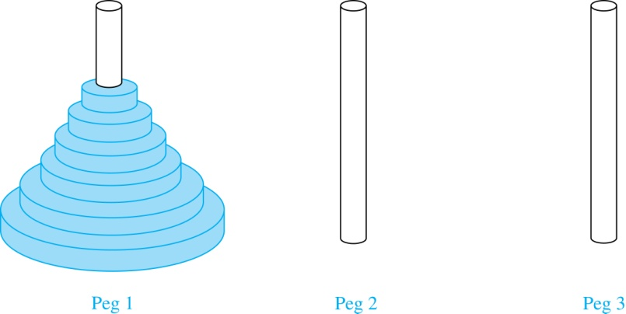
The Tower of Hanoi
A puzzle consisting of three pegs on a board with disks of different sizes.
Initially all of the disks are on the first peg in order of size, with the largest on the bottom.

Slide 9
The Tower of Hanoi - Rules
Rules: You are allowed to move the disks one at a time from one peg to another as long as a larger disk is never placed on a smaller.
Goal: Using allowable moves, end up with all the disks on the second peg in order of size with largest on the bottom.
Question: How many moves are needed?
Let {H_{n}} denote the number of moves needed to solve the Tower of Hanoi Puzzle with n disks.
The initial condition is H₁= 1 since a single disk can be transferred from peg 1 to peg 2 in one move.

Slide 10
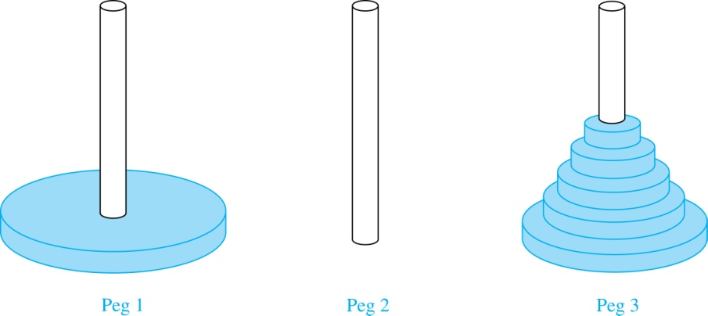
The Tower of Hanoi – Initial Move
Begin with n disks on peg 1. We can transfer the top n −1 disks, following the rules of the puzzle, to peg 3 using H_{n−1} moves.

Slide 11
The Tower of Hanoi – Recursion
Then, we use 1 move to transfer the largest disk to the second peg.
Then we transfer the n −1 disks from peg 3 to peg 2 using H_{n−1} additional moves.
Hence, H_{n} = 2H_{n−1} + 1.

Slide 12
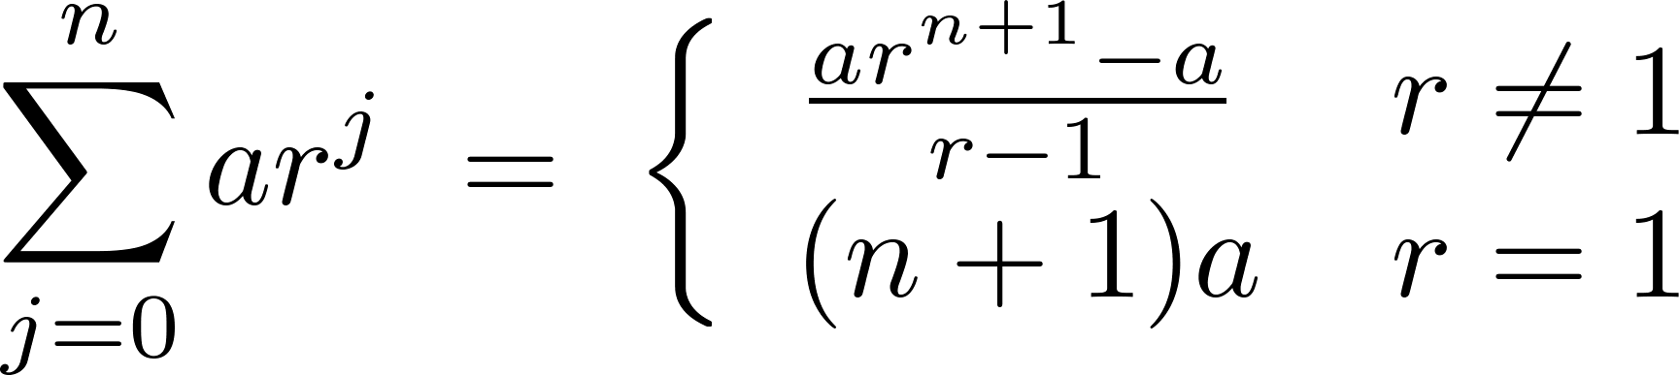
The Tower of Hanoi – Solving the Recurrence
H_{n} = 2H_{n−1} + 1
= 2 (2H_{n−2} + 1) + 1 = 2² H_{n−2} + 2 + 1
= 2² (2H_{n−3} + 1) + 2 + 1 = 2³ H_{n−3} + 2² + 2 + 1
⋮
= 2^{n-1} H₁ + 2^{n−2} + 2^{n−3} + …. + 2 + 1
= 2^{n−1} + 2^{n−2} + 2^{n−3} + …. + 2 + 1 since H₁= 1
= 2^{n} − 1 sum of the terms of a geometric series

Slide 13
The Tower of Hanoi - History
There was a myth created around the puzzle:
Monks in a tower in Hanoi are transferring 64 golden disks from one peg to another following the rules of the puzzle. They move one disk each day. When the puzzle is finished, the world will end.
Using the closed formula for the 64 golden disks
2⁶⁴ −1 = 18,446, 744,073, 709,551,615
days are needed to solve the puzzle, which is more than 500 billion years.

Slide 14
Counting the Ways to Parenthesize a Product
Find a recurrence relation for C_{n} , the number of ways to parenthesize the product of n + 1 numbers, x₀ ∙ x₁ ∙ x₂ ∙ ⋯ ∙ x_{n}, to specify the order of multiplication.
For example, C₃ = 5, since all the possible ways to parenthesize 4 numbers are
((x₀ ∙ x₁ )∙ x₂ )∙ x₃
(x₀ ∙ (x₁ ∙ x₂ ))∙ x₃
(x₀ ∙ x₁ )∙ (x₂ ∙ x₃ )
x₀ ∙ (( x₁ ∙ x₂ ) ∙ x₃ )
x₀ ∙ ( x₁ ∙ ( x₂ ∙ x₃ ))

Slide 15
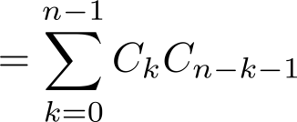
Counting the Ways to Parenthesize a Product
Note that however parentheses are inserted in x₀ ∙ x₁ ∙ x₂ ∙ ⋯ ∙ x_{n}, one multiplication operator remains outside all parentheses.
This final operator appears between two of the n + 1 numbers, say x_{k} and x_{k+1}.
There are C_{k} ways to insert parentheses in the product x₀ ∙ x₁ ∙ x₂ ∙ ⋯ ∙ x_{k}
There are C_{n−k−1} ways to insert parentheses in the product x_{k+1} ∙ x_{k+2} ∙ ⋯ ∙ x_{n}
Therefore we have
The initial conditions are C₀ = 1 and C₁ = 1.
The sequence {C_{n} } is the sequence of Catalan Numbers.

Slide 16
Summary
Counting with Recurrence Relations
Counting Bitstrings – same recurrence for different problems
The Tower of Hanoi – recurrence we can solve
Counting Arrangments of Parantheses – recurrence hard to solve

Slide 17
Solving Linear Recurrence Relations
Section 8.2

Slide 18
Video 68: Linear Recurrence Relations
Linear Homogeneous Recurrence Relations
Solving Linear Homogeneous Recurrence Relations

Slide 19
Linear Homogeneous Recurrence Relations
Definition: A linear homogeneous recurrence relation of degree k with constant coefficients is a recurrence relation of the form
a_{n} = c₁a_{n−1} + c₂a_{n−2} + ….. + c_{k} a_{n−k}
where c₁, c₂, ….,c_{k} are real numbers, and c_{k} ≠ 0
By strong induction, a sequence satisfying such a recurrence relation is uniquely determined by the recurrence relation and the k initial conditions a₀ = C₁, a₀ = C₁ ,… , a_{k−1} = C_{k−1}.

Slide 20
Terminology explained
a_{n} = c₁a_{n−1} + c₂a_{n−2} + ….. + c_{k} a_{n−k}
is linear because the right-hand side is a sum of the previous terms of the sequence each multiplied by a function of n.
is homogeneous because no terms occur that are not multiples of the a_{j}s.
has constant coefficients c₁, c₂, ….,c_{k}.
the degree is k because a_{n} is expressed in terms of the previous k terms of the sequence.

Slide 21
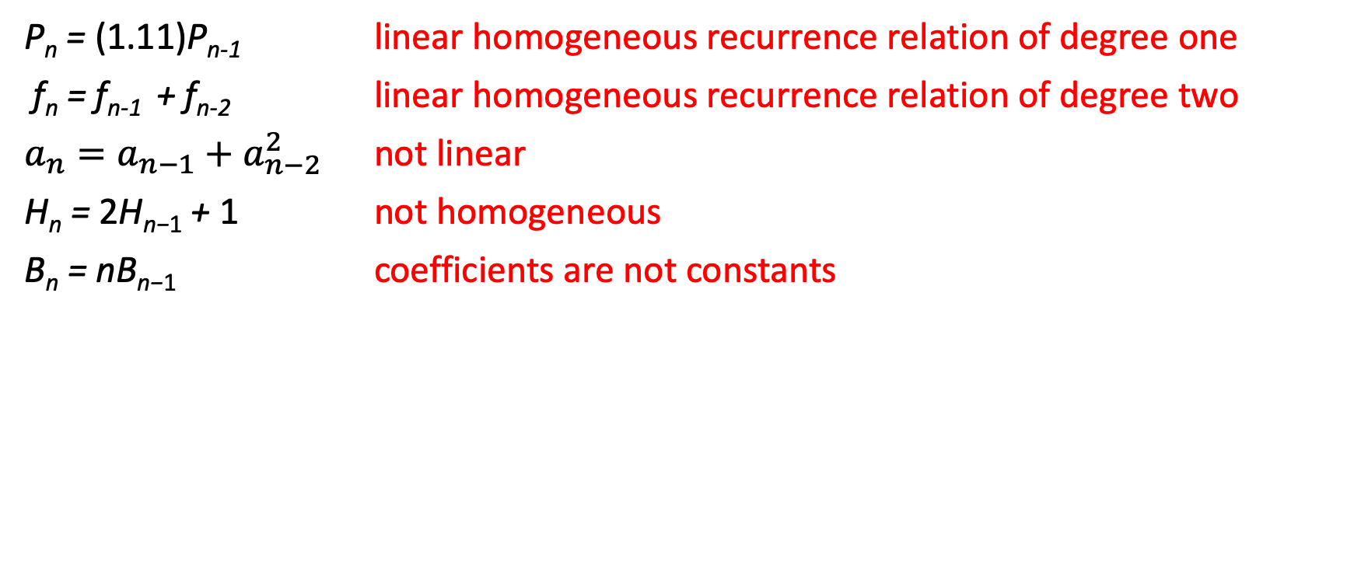
Examples
P_{n} = (1.11)P_{n-1} linear homogeneous recurrence relation of degree one
f_{n} = f_{n-1} + f_{n-2} linear homogeneous recurrence relation of degree two
$a_{n}=a_{n−1}+a_{n−2}^{2}$ not linear
H_{n} = 2H_{n−1} + 1 not homogeneous
B_{n} = nB_{n−1} coefficients are not constants

Slide 22
Characteristic Equation
Given the recurrence relation a_{n} = c₁a_{n−1} + c₂a_{n−2} + ⋯ + c_{k} a_{n−k} assume a_{n} = r^{n} , where r is a constant
Substituting into the recurrence relation gives
r^{n} = c₁r^{n−1} + c₂r^{n−2} + ⋯ + c_{k} r^{n−k}
Algebraic manipulation yields the characteristic equation:
r^{k} − c₁r^{k−1} − c₂r^{k−2} − ⋯ − c_{k−1}r − c_{k} = 0

Slide 23
Solving Linear Homogeneous Recurrence Relations
The sequence {a_{n}} with a_{n} = r^{n} is a solution if and only if r is a solution to the characteristic equation.
The solutions to the characteristic equation are called the characteristic roots of the recurrence relation.
The roots can be used to give an closed formula for the recurrence relation.

Slide 24
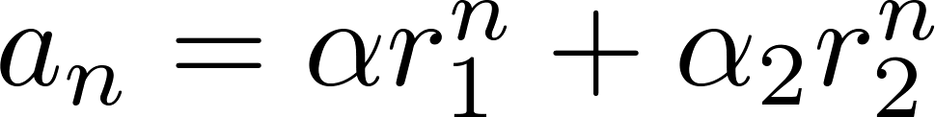
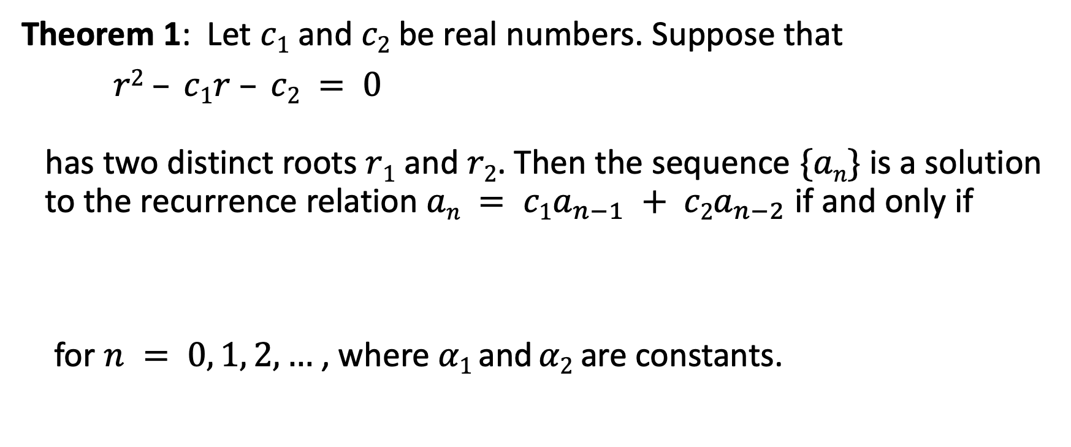
Solving Linear Homogeneous Recurrence Relations of Degree Two
Theorem 1: Let $c1$ and $c2$ be real numbers. Suppose that
$r2 – c1r – c2 = 0$ has two distinct roots $r1$ and $r2$. Then the sequence $\{an\}$is a solution to the recurrence relation $an = c1a_{n−1} + c2a_{n−2}$ if and only if
for $n = 0, 1, 2,…$, where $α1$ and $α2$are constants.

Slide 25
Example
What is the solution to the recurrence relation a_{n} = a_{n−1} + 2a_{n−2} with a₀ = 2 and a₁ = 7?
The characteristic equation is r² − r − 2 = 0.
Its roots are r = 2 and r = −1 .
Therefore, {a_{n}} is a solution to the recurrence relation if and only if a_{n} = α₁2^{n} + α₂(−1)^{n}, for some constants α₁ and α₂.
To find the constants α₁ and α₂, note that
a₀ = 2 = α₁ + α₂ and a₁ = 7 = α₁2 + α₂(−1).
Solving these equations, we find that α₁ = 3 and α₂ = −1.
Hence, the solution is the sequence {a_{n}} with a_{n} = 3∙2^{n} − (−1)^{n}.

Slide 26
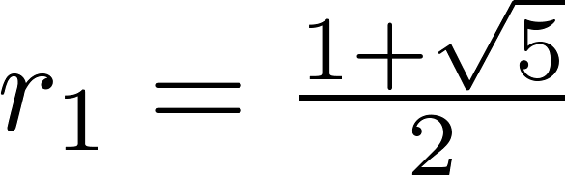
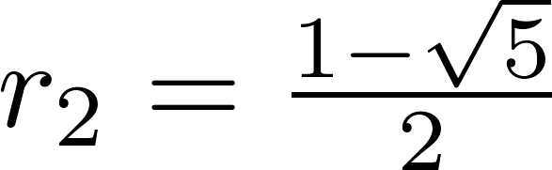
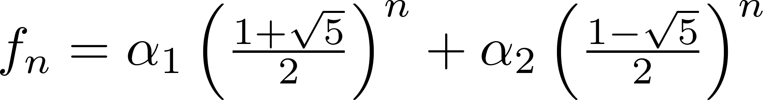
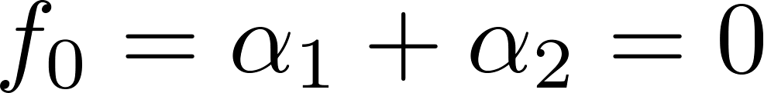
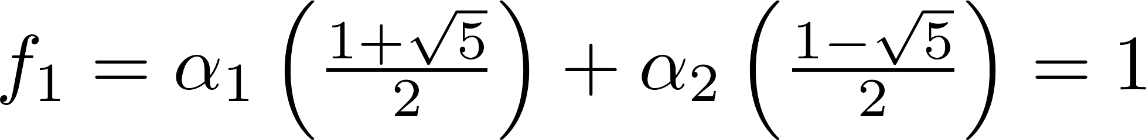
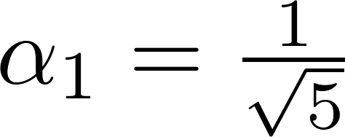
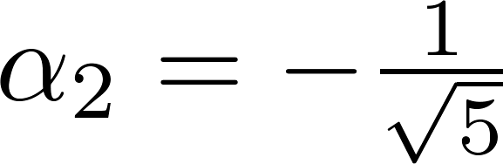
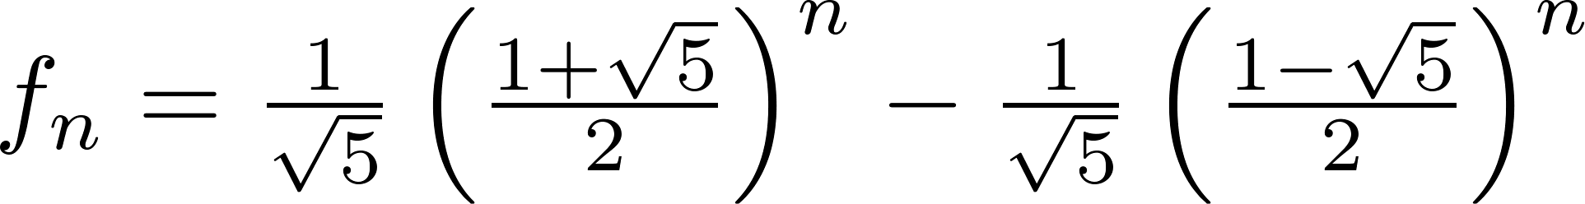
Example: Fibonacci Numbers
The sequence of Fibonacci numbers satisfies the recurrence relation f_{n} = f_{n−1} + f_{n−2} with the initial conditions: f₀ = 0 and f₁ = 1.
The characteristic equation is r² – r – 1
And it’s roots are
Therefore
Using the initial conditions f₀ = 0 and f₁ = 1 , we have
Solving for α₁ and α₂
Hence

Slide 27
Summary
Linear Homogeneous Recurrence Relations
Characteristic equation
Characteristic roots
Solving Linear Homogeneous Recurrence Relations of degree 2 with Constant Coefficients

Slide 28
Video 69: General Linear Recurrence Relations
Homogeneous Recurrence Relations with Repeated Root
Linear Homogeneous Recurrence Relations of Arbitrary Degree

Slide 29
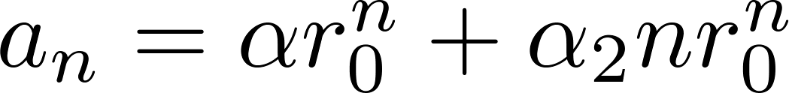
Solving Linear Homogeneous Recurrence Relations with Repeated Root
Theorem 2: Let c₁ and c₂ be real numbers with c₂ ≠ 0. Suppose that r² – c₁r – c₂ = 0 has one repeated root r₀. Then the sequence {a_{n}} is a solution to the recurrence relation a_{n} = c₁a_{n−1} + c₂a_{n−2} if and only if
for n = 0, 1, 2,… , where α and α₂ are constants.

Slide 30
Example
What is the solution to the recurrence relation a_{n} = 6a_{n−1} − 9a_{n−2} with a₀ = 1 and a₁ = 6?
The characteristic equation is r² − 6r + 9 = 0.
The only root is r = 3.
Therefore, {a_{n}} is a solution to the recurrence relation if and only if a_{n} = α₁3^{n} + α₂n(3)^{n} where α₁ and α₂ are constants.
To find the constants α₁ and α₂, note that
a₀ = 1 = α₁ and a₁ = 6 = α₁ ∙ 3 + α₂ ∙3.
Solving, we find that α₁ = 1 and α₂ = 1 .
Hence, a_{n} = 3^{n} + n3^{n} .

Slide 31
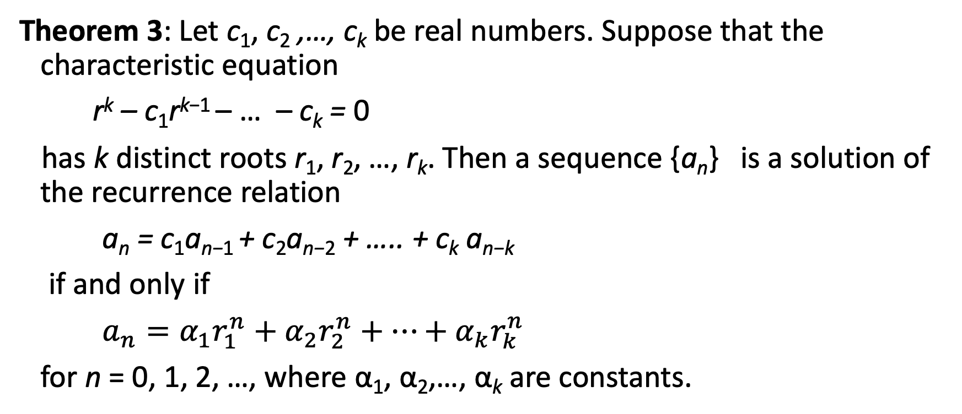
Solving Linear Homogeneous Recurrence Relations of Arbitrary Degree
Theorem 3: Let c₁, c₂ ,…, c_{k} be real numbers. Suppose that the characteristic equation
r^{k} – c₁r^{k−1} – … – c_{k} = 0
has k distinct roots r₁, r₂, …, r_{k}. Then a sequence {a_{n}} is a solution of the recurrence relation
a_{n} = c₁a_{n−1} + c₂a_{n−2} + ….. + c_{k} a_{n−k}
if and only if
$a_{n}=α_{1}r_{1}^{n}+α_{2}r_{2}^{n}+…+α_{k}r_{k}^{n}$
for n = 0, 1, 2, …, where α₁, α₂,…, α_{k} are constants.

Slide 32
The General Case with Repeated Roots Allowed
Theorem 4: Let c₁, c₂ ,…, c_{k} be real numbers. Suppose that the characteristic equation
r^{k} – c₁r^{k−1} –⋯ – c_{k} = 0
has t distinct roots r₁, r₂, …, r_{t} with multiplicities m₁, m₂, …, m_{t}, respectively so that m_{i} ≥ 1 for i = 0, 1, 2, …,t and m₁ + m₂ + … + m_{t} = k. Then a sequence {a_{n}} is a solution of the recurrence relation
a_{n} = c₁a_{n−1} + c₂a_{n−2} + ….. + c_{k} a_{n−k}
if and only if
for n = 0, 1, 2, …, where α_{i,j} are constants for 1≤ i ≤ t and 0 ≤ j ≤ m_{i−1}.

Slide 33
Example
What is the solution to the recurrence relation a_{n} = −3a_{n−1} − 3a_{n−2} − a_{n−3} with a₀ = 1, a₁ = −2, and a₂ = −1.
The characteristic equation is r³ + 3r² + 3r + 1 = 0.
The only root is r = -1.
Therefore, {a_{n}} is a solution to the recurrence relation if and only if a_{n} = α_{1,0}(−1)^{n} + α_{1,1}n(−1)^{n} + α_{1,2}n²(−1)^{n}
where α_{1,0}, α_{1,1} and α_{1,2} are constants.
To find the constants α_{1,0}, α_{1,1} and α_{1,2} , note that
a₀ = 1 = α_{1,0} a₁ = -2 = - α_{1,0} - α_{1,1} - α_{1,1} a₂ = -2 = α_{1,0} + 2α_{1,1} + 4α_{1,1}
Solving, we find that α_{1,0} = 1, α_{1,1} = 3 and α_{1,2} = -2
Hence, a_{n} = (1 + 3n − 2n² )(−1)^{n}

Slide 34
Summary
Homogeneous Recurrence Relations with Repeated Root
Linear Homogeneous Recurrence Relations of Arbitrary Degree

Slide 35
Generating Functions
Section 8.4

Slide 36
Video 70: Generating Functions
Generating Functions
Solving recurrence relations with generating functions

Slide 37
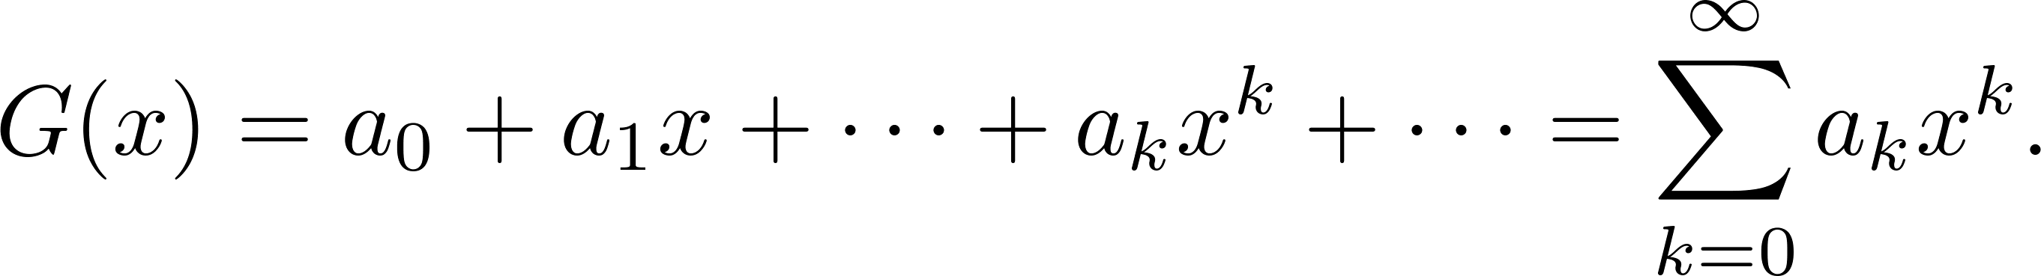
Generating Functions
Definition: The generating function for the infinite sequence a₀, a₁,…, a_{k}, … of real numbers is the infinite series

Slide 38
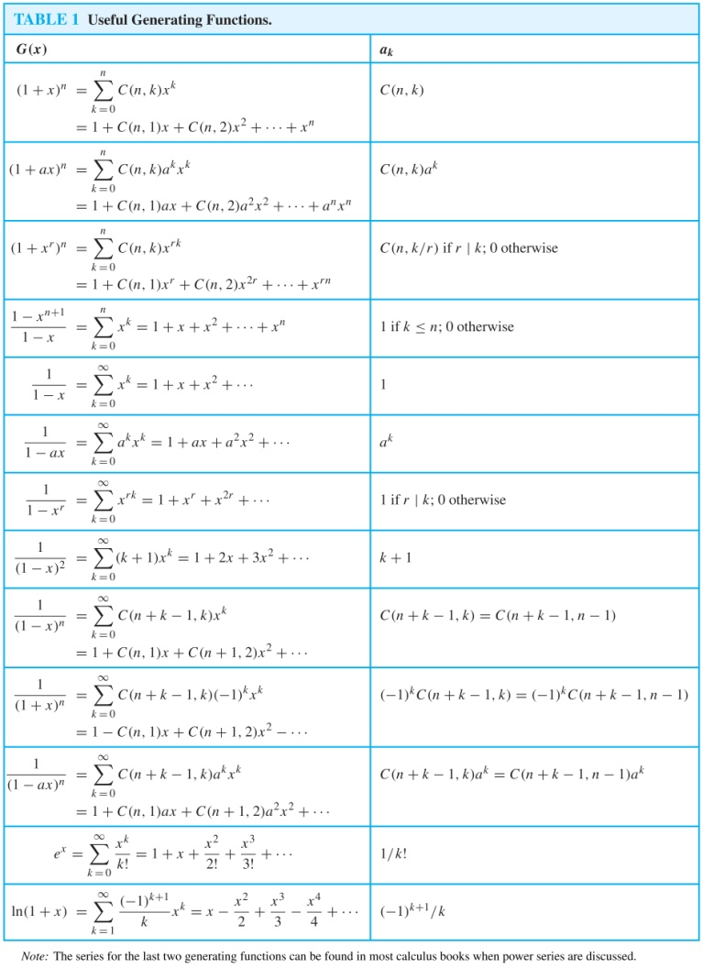
Useful Generating Functions

Slide 39
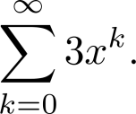
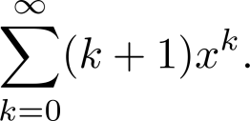
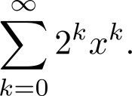
Examples
The sequence {a_{k}} with a_{k} = 3 has the generating function
The sequence {a_{k}} with a_{k} = k + 1 has the generating function has the generating function
The sequence {a_{k}} with a_{k} = 2^{k} has the generating function has the generating function

Slide 40

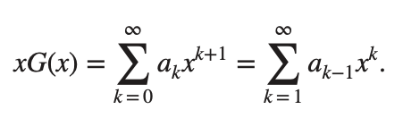
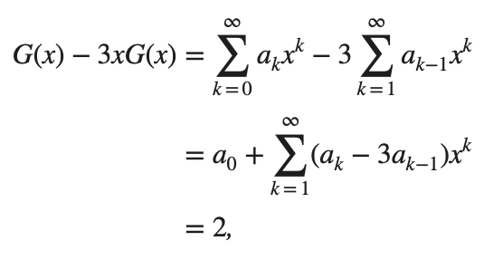
Solving Recurrence Relations with Generating Functions
Solve the recurrence relation a_{k} = 3a_{k-1} with initial condition a₀ = 2.
Take the generating function
Observe that
Now we see that

Slide 41



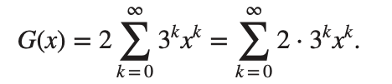

Solving Recurrence Relations with Generating Functions
Thus
or
Using
We get
And thus

Slide 42
Solving Recurrence Relations with Generating Functions
Given some recurrence relation for a sequence a₀, a₁,…, a_{k}, …
General Approach to find a closed formula
Interpret the sequence as coefficients of a generating function G(x)
Use the recurrence relation to derive an alternative expression for G(x)
Determine the power expansion of this alternative expression of which the coefficients must be equal to the sequence

Slide 43
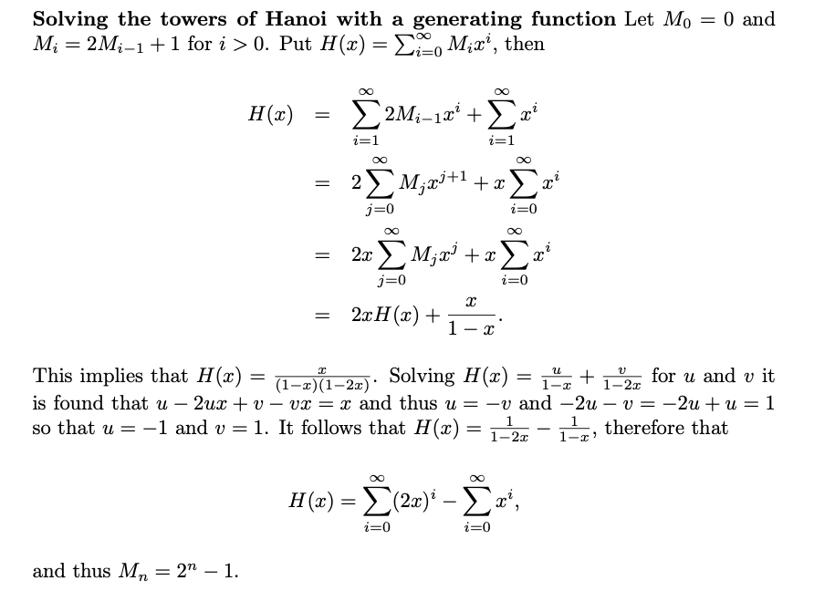
Solving Hanoi Tower

Slide 44
Summary
Generating Functions
Useful generating functions
Solving recurrence relations with generating functions

Slide 45
Video 71: Counting Problems
Solving counting problems with generating functions

Slide 46
Counting Problems and Generating Functions
Find the number of solutions of
e₁ + e₂ + e₃ = 17,
where e₁, e₂, and e₃ are nonnegative integers with
2 ≤ e₁ ≤ 5, 3 ≤ e₂ ≤ 6, and 4 ≤ e₃ ≤ 7.
The number of solutions is the coefficient of x¹⁷ in the expansion of
f(x) = (x² + x³ + x⁴ + x⁵) (x³ + x⁴ + x⁵ + x⁶) (x⁴ + x⁵ + x⁶ + x⁷).
A term equal to x¹⁷ is obtained in the product by picking x^{e1} in the first sum, x^{e2} in the second sum x^{e2}, and x^{e3} in the third sum x^{e3}, such that e₁ + e₂ + e₃ = 17.
There are three solutions since the coefficient of x¹⁷ in the product is 3.

Slide 47
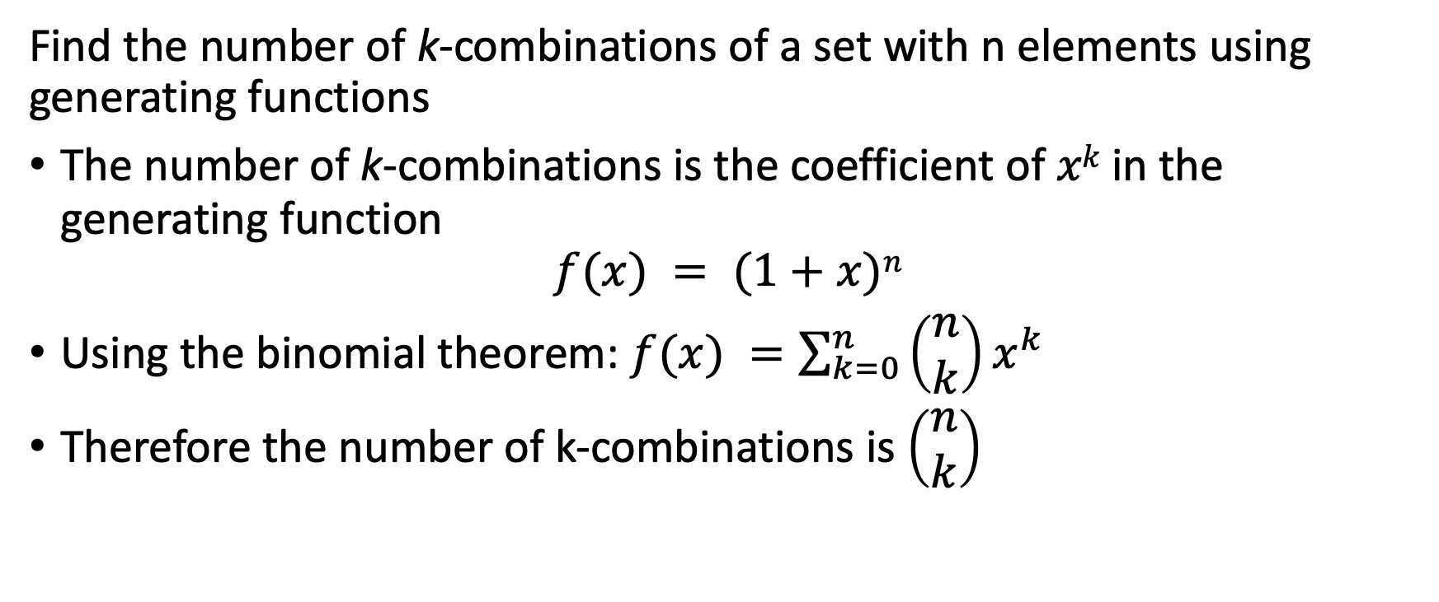
Combinations
Find the number of k-combinations of a set with n elements using generating functions
The number of k-combinations is the coefficient of $xk$ in the generating function
$$f(x) = (1+x)n$$
Using the binomial theorem: $f(x) =\sum_{k=0}^{n}{\left(\begin{matrix}n \\ k\end{matrix}\right)x^{k}}$
Therefore the number of k-combinations is $\left(\begin{matrix}n \\ k\end{matrix}\right)$

Slide 48
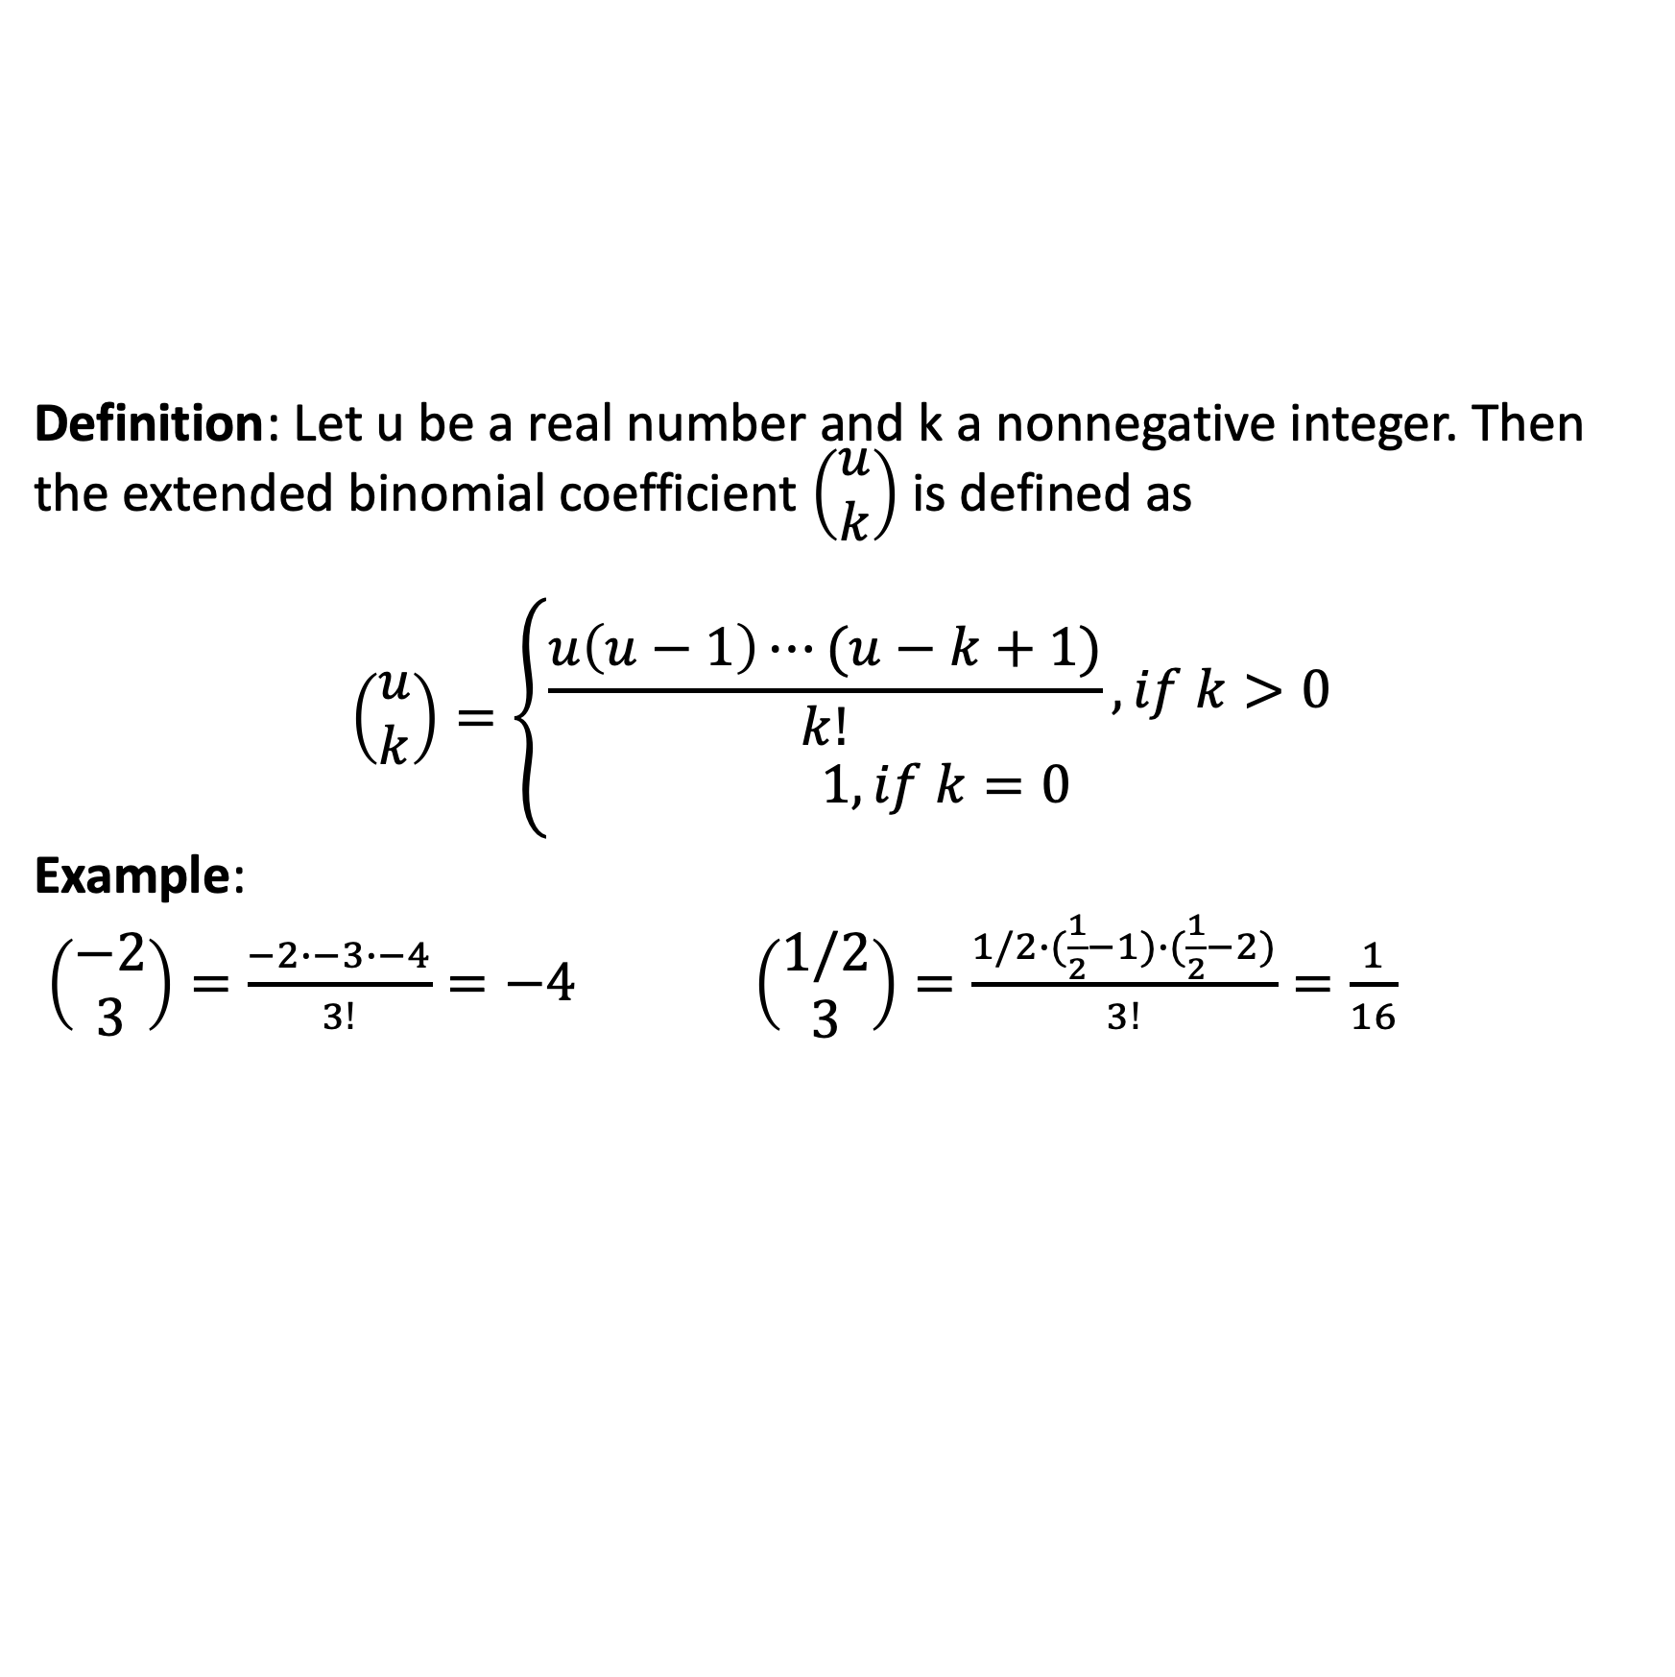
Extended Binomial Coefficients
Definition: Let u be a real number and k a nonnegative integer. Then the extended binomial coefficient $\left(\begin{matrix}u \\ k\end{matrix}\right)$ is defined as
$$\left(\begin{matrix}u \\ k\end{matrix}\right)=\left\{\begin{matrix}\frac{u\left(u−1\right)⋯(u−k+1)}{k!},if k>0 \\ 1,if k=0\end{matrix}\right.$$
Example:
$\left(\begin{matrix}−2 \\ 3\end{matrix}\right)=\frac{−2∙−3∙−4}{3!}=−4$ $\left(\begin{matrix}1/2 \\ 3\end{matrix}\right)=\frac{1/2∙(\frac{1}{2}−1)∙(\frac{1}{2}−2)}{3!}=\frac{1}{16}$

Slide 49
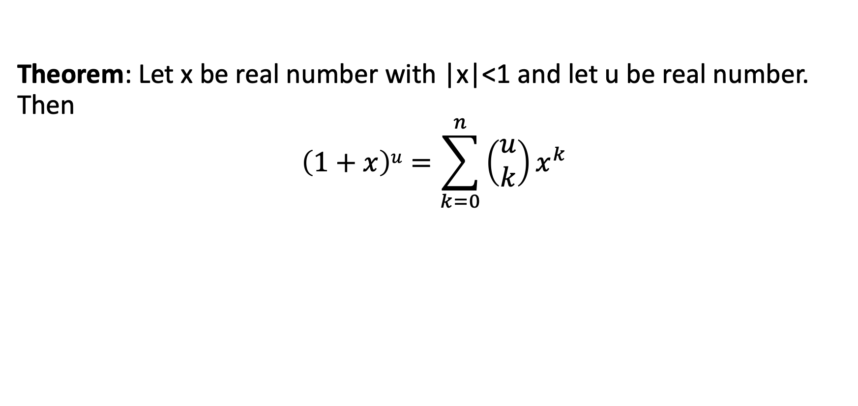
Extended Binomial Theorem
Theorem: Let x be real number with |x|<1 and let u be real number. Then
$$\left(1+x\right)u=\sum_{k=0}^{n}{\left(\begin{matrix}u \\ k\end{matrix}\right)x^{k}}$$

Slide 50
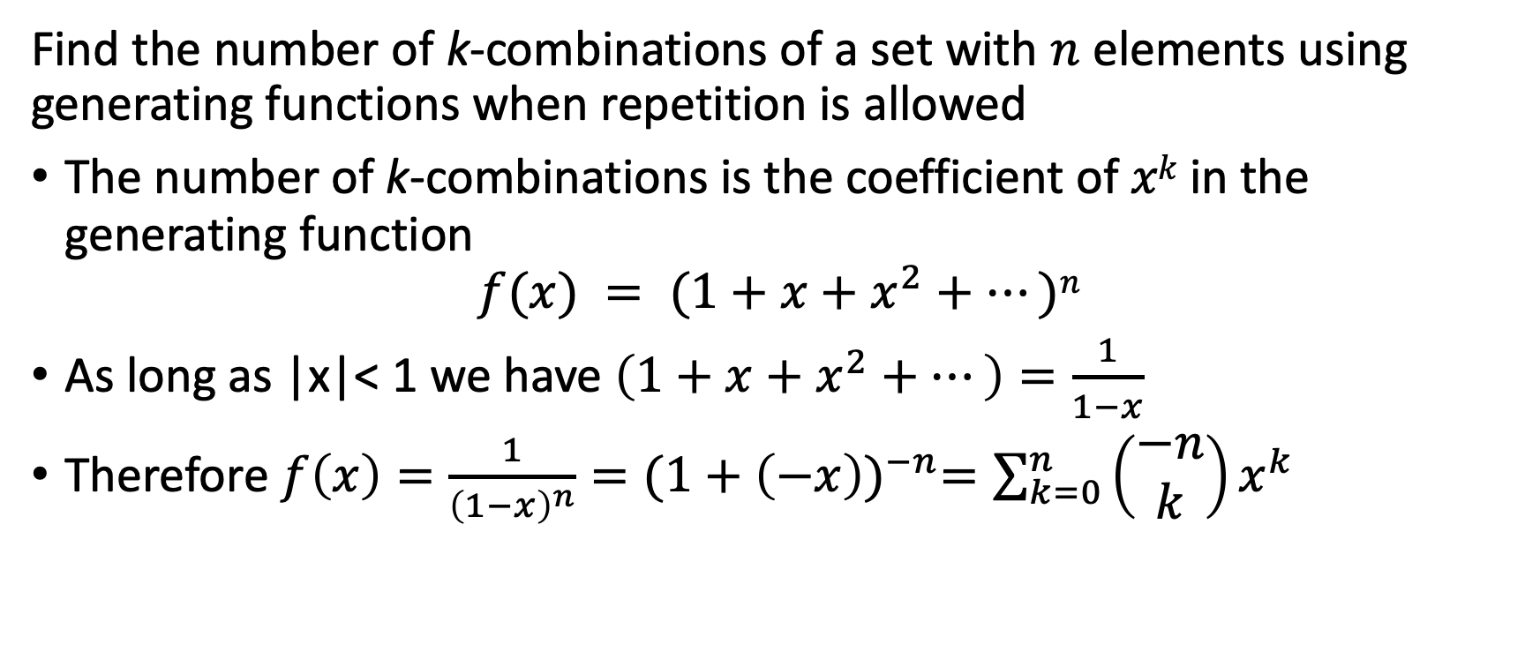
Combinations with Repetition
Find the number of k-combinations of a set with $n$ elements using generating functions when repetition is allowed
The number of k-combinations is the coefficient of $xk$ in the generating function
$$f(x) = (1+x+x^{2}+⋯)n$$
As long as |x|< 1 we have $\left(1+x+x^{2}+⋯\right)=\frac{1}{1−x}$
Therefore $f\left(x\right)=\frac{1}{{\left(1−x\right)}^{n}}{=(1+\left(−x\right))}^{−n}=\sum_{k=0}^{n}{\left(\begin{matrix}−n \\ k\end{matrix}\right)x^{k}}$

Slide 51
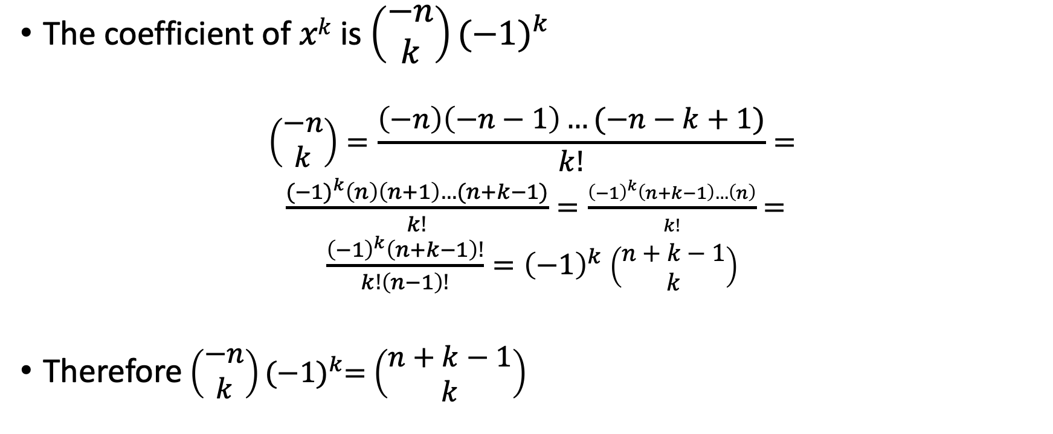
Combinations with Repetition
The coefficient of $xk$ is $\left(\begin{matrix}−n \\ k\end{matrix}\right){(−1)}^{k}$
$$\left(\begin{matrix}−n \\ k\end{matrix}\right)=\frac{\left(−n\right)\left(−n−1\right)…(−n−k+1)}{k!}=$$
$\frac{{(−1)}^{k}\left(n\right)\left(n+1\right)…(n+k−1)}{k!}=\frac{{\left(−1\right)}^{k}\left(n+k−1\right)…\left(n\right)}{k!}=$
$\frac{{\left(−1\right)}^{k}\left(n+k−1\right)!}{k!\left(n−1\right)!}={\left(−1\right)}^{k}$ $\left(\begin{matrix}n+k−1 \\ k\end{matrix}\right)$
Therefore $\left(\begin{matrix}−n \\ k\end{matrix}\right){(−1)}^{k}=$ $\left(\begin{matrix}n+k−1 \\ k\end{matrix}\right)$

Slide 52
Summary
Counting combinations with generating functions
Extended Binomial Theorem
Counting Combinations with Repetition with generating functions

Slide 53
Inclusion-Exclusion
Section 8.5

Slide 54
Video 72: Inclusion-Exclusion
The Principle of Inclusion-Exclusion
Examples

Slide 55
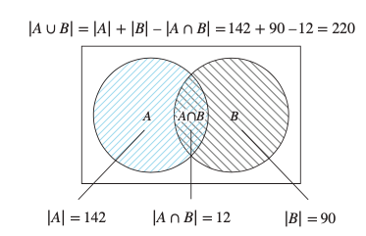
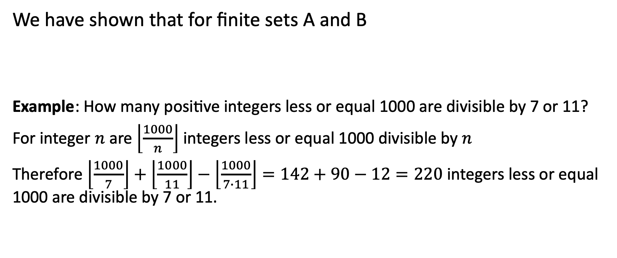
Principle of Inclusion-Exclusion
We have shown that for finite sets A and B
Example: How many positive integers less or equal 1000 are divisible by 7 or 11?
For integer $n$ are $\left\lfloor \frac{1000}{n}\right\rfloor$ integers less or equal 1000 divisible by $n$
Therefore $\left\lfloor \frac{1000}{7}\right\rfloor +\left\lfloor \frac{1000}{11}\right\rfloor −\left\lfloor \frac{1000}{7∙11}\right\rfloor =142+90−12=220$ integers less or equal 1000 are divisible by 7 or 11.

Slide 56
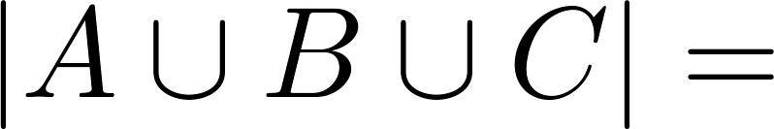
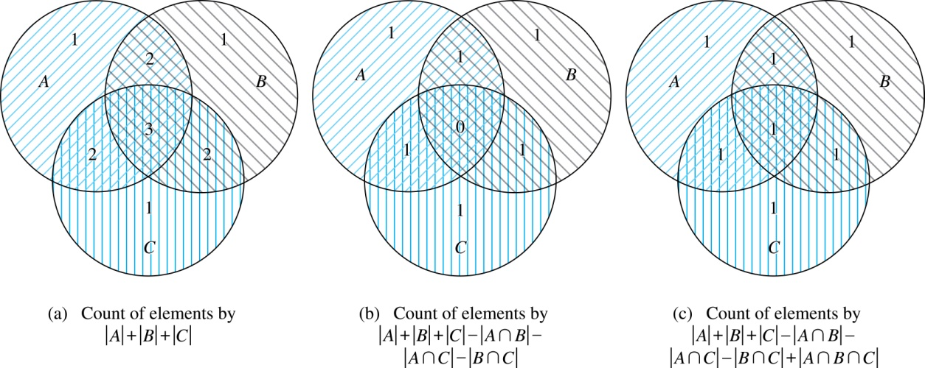
Three Finite Sets

Slide 57
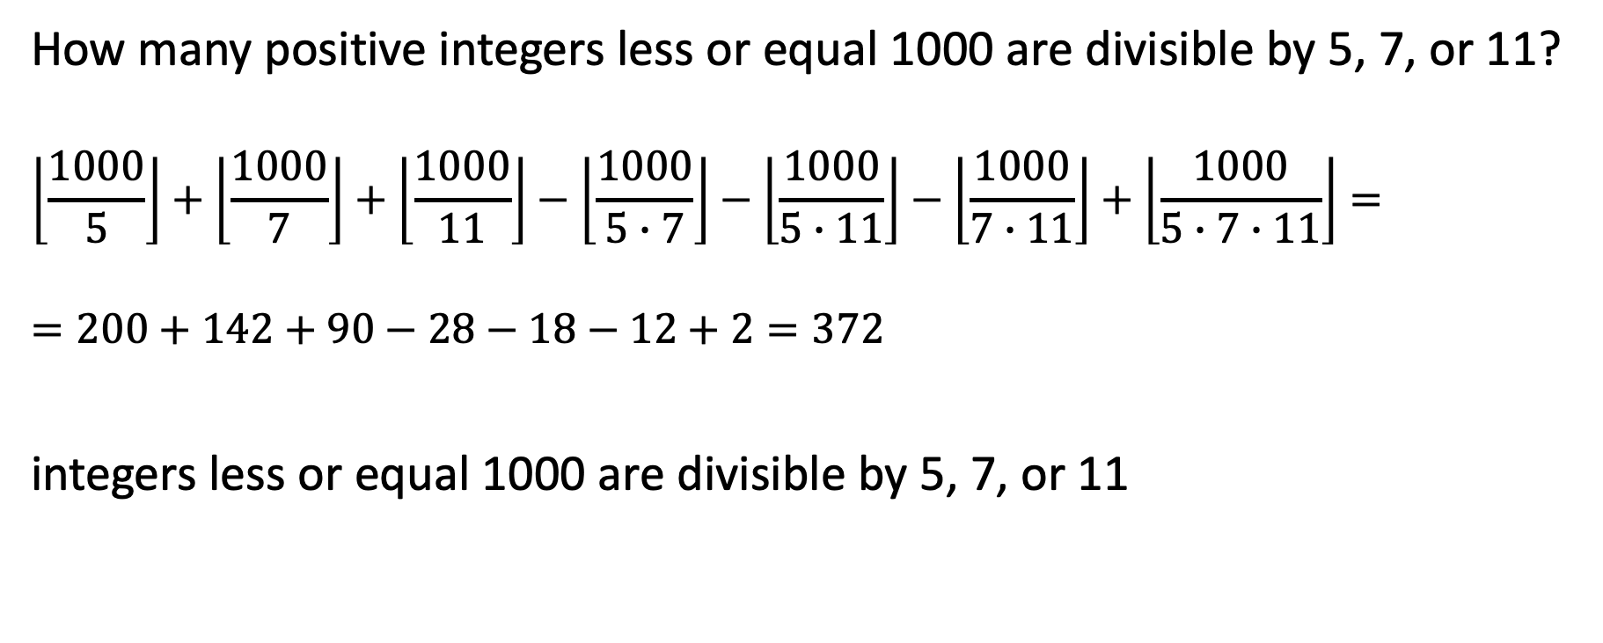
Example
How many positive integers less or equal 1000 are divisible by 5, 7, or 11?
$$\left\lfloor \frac{1000}{5}\right\rfloor +\left\lfloor \frac{1000}{7}\right\rfloor +\left\lfloor \frac{1000}{11}\right\rfloor −\left\lfloor \frac{1000}{5∙7}\right\rfloor −\left\lfloor \frac{1000}{5∙11}\right\rfloor −\left\lfloor \frac{1000}{7∙11}\right\rfloor +\left\lfloor \frac{1000}{5∙7∙11}\right\rfloor =$$
$=200+142+90−28−18−12+2=372$
integers less or equal 1000 are divisible by 5, 7, or 11

Slide 58
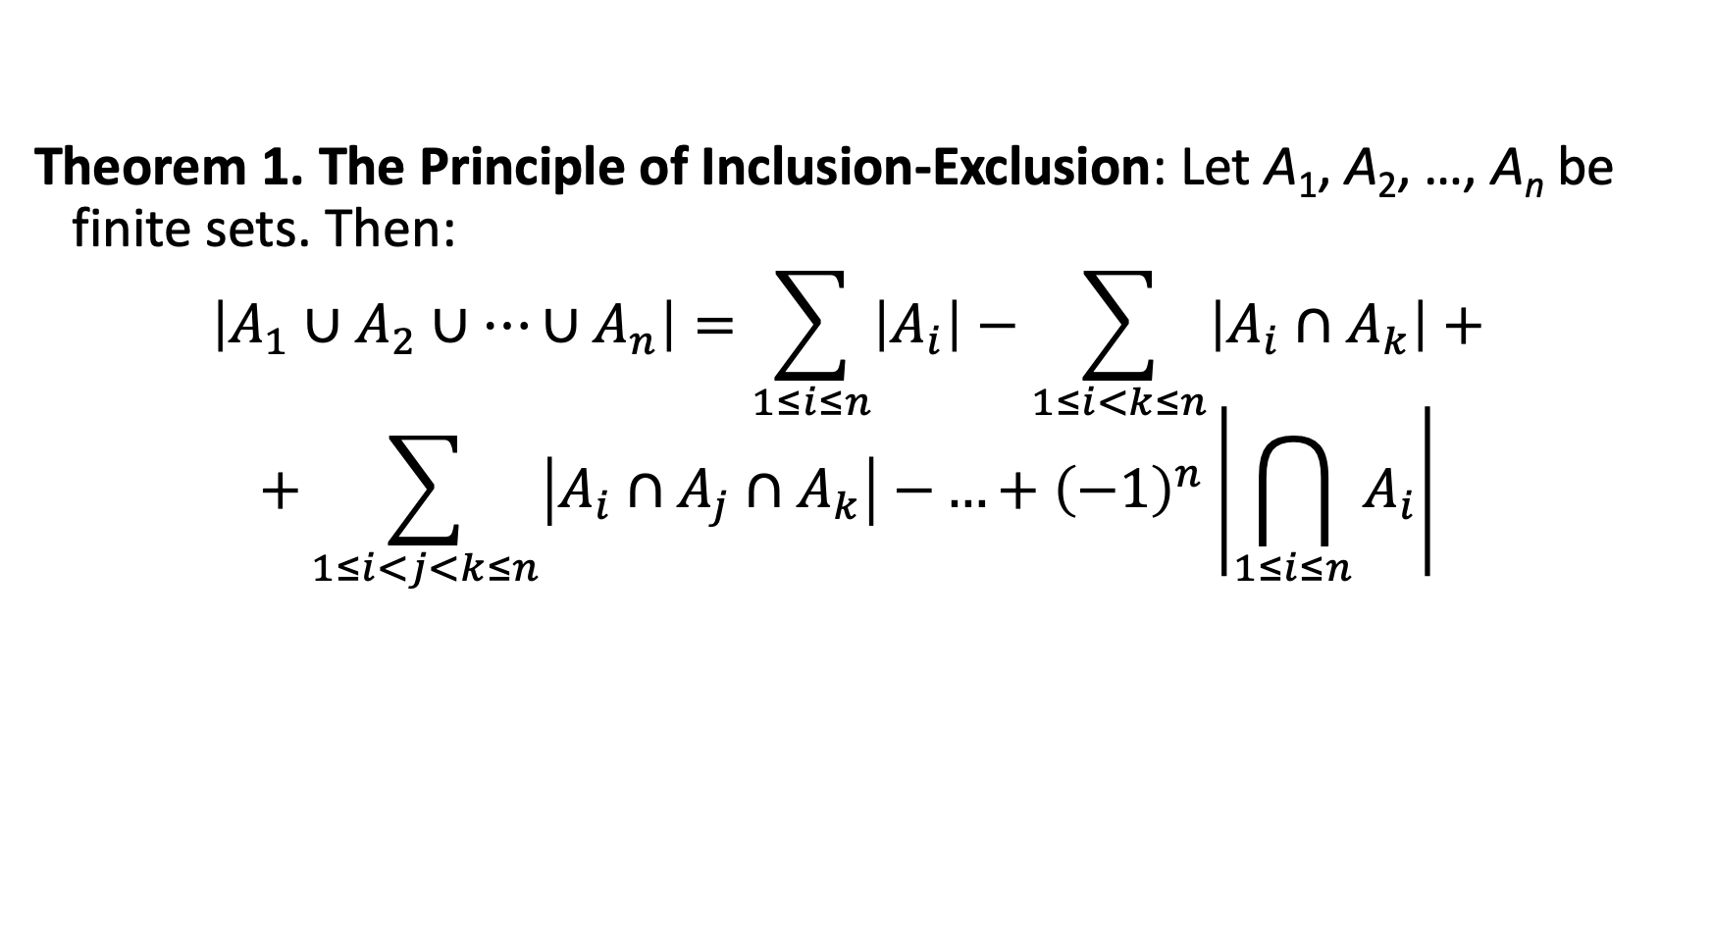
The Principle of Inclusion-Exclusion
Theorem 1. The Principle of Inclusion-Exclusion: Let A₁, A₂, …, A_{n} be finite sets. Then: $$\left|A_{1}∪A_{2}∪…∪A_{n}\right|=\sum_{1≤i≤n}{\left|A_{i}\right|}−\sum_{1≤i<k≤n}{\left|A_{i}∩A_{k}\right|+}$$
$$+\sum_{1≤i<j<k≤n}{\left|A_{i}∩A_{j}∩A_{k}\right|−}…+{\left(−1\right)}^{n}\left|\bigcap_{1≤i≤n}{A_{i}}\right|$$

Slide 59
The Principle of Inclusion-Exclusion
Proof: Consider an element a that is a member of r of the sets A₁, …., A_{n} where 1 ≤ r ≤ n.
It is counted C(r, 1) times by Σ|A_{i}|
It is counted C(r, 2) times by Σ|A_{i} ⋂A_{j}|
In general, it is counted C(r, m) times by the summation of m of the sets A_{i}.

Slide 60
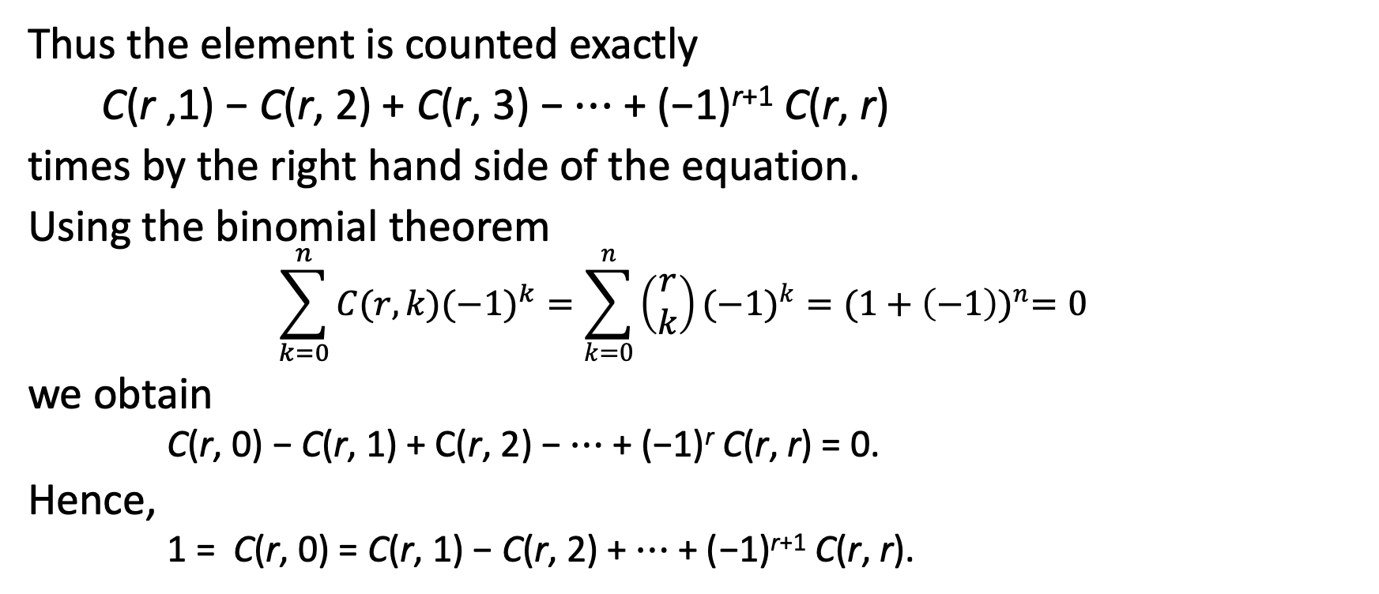
The Principle of Inclusion-Exclusion
Thus the element is counted exactly
C(r ,1) − C(r, 2) + C(r, 3) − ⋯ + (−1)^{r+1} C(r, r)
times by the right hand side of the equation.
Using the binomial theorem
$$\sum_{k=0}^{n}{C(r,k){(−1)}^{k}}=\sum_{k=0}^{n}{\left(\begin{matrix}r \\ k\end{matrix}\right){(−1)}^{k}}={(1+\left(−1\right))}^{n}=0$$
we obtain
C(r, 0) − C(r, 1) + C(r, 2) − ⋯ + (−1)^{r} C(r, r) = 0.
Hence,
1 = C(r, 0) = C(r, 1) − C(r, 2) + ⋯ + (−1)^{r+1} C(r, r).

Slide 61
Derangements
Definition: A derangement is a permutation of objects that leaves no object in the original position.
Example:
The permutation of 21453 is a derangement of 12345.
But 21543 is not a derangement of 12345, because 4 is in its original position.

Slide 62
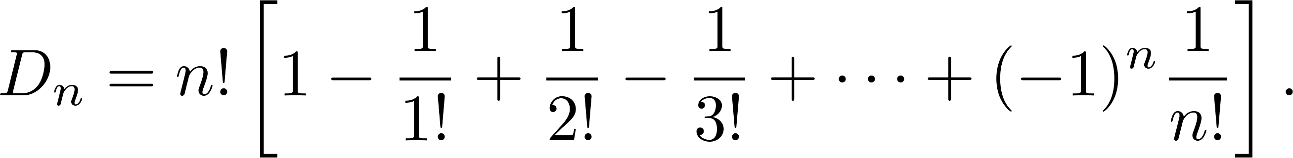
Derangements
Theorem 2: The number of derangements of a set with n elements is

Slide 63
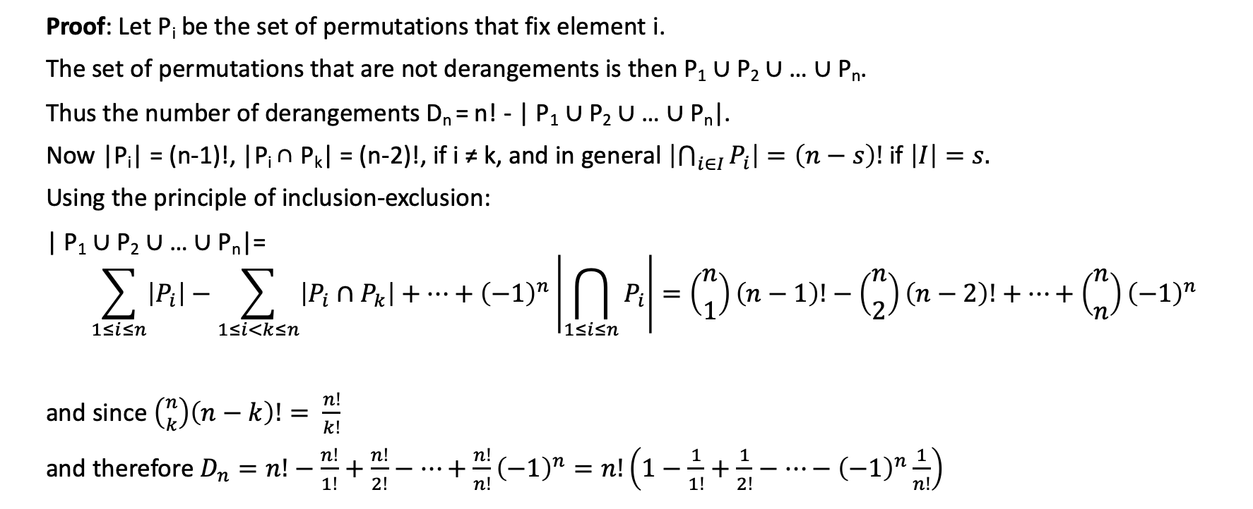
Derangements - Proof
Proof: Let P_{i} be the set of permutations that fix element i.
The set of permutations that are not derangements is then P₁ ∪ P₂ ∪ … ∪ P_{n}.
Thus the number of derangements D_{n} = n! - | P₁ ∪ P₂ ∪ … ∪ P_{n}|.
Now |P_{i}| = (n-1)!, |P_{i} ∩ P_{k}| = (n-2)!, if i ≠ k, and in general $\left|\bigcap_{i∈I}{P_{i}}\right|=\left(n−s\right)!$ if $\left|I\right|=s.$
Using the principle of inclusion-exclusion:
| P₁ ∪ P₂ ∪ … ∪ P_{n}|=
$$\sum_{1≤i≤n}{\left|P_{i}\right|}−\sum_{1≤i<k≤n}{\left|P_{i}∩P_{k}\right|+…+{\left(−1\right)}^{n}\left|\bigcap_{1≤i≤n}{P_{i}}\right|}=\left({n \atop 1}\right)\left(n−1\right)!−\left({n \atop 2}\right)\left(n−2\right)!+…+\left({n \atop n}\right){\left(−1\right)}^{n}$$
and since $\left({n \atop k}\right)\left(n−k\right)!= \frac{n!}{k!}$
and therefore $D_{n}=n!−\frac{n!}{1!}+\frac{n!}{2!}−…+\frac{n!}{n!}{\left(−1\right)}^{n}=n!\left(1−\frac{1}{1!}+\frac{1}{2!}−…−{\left(−1\right)}^{n}\frac{1}{n!}\right)$

Slide 64
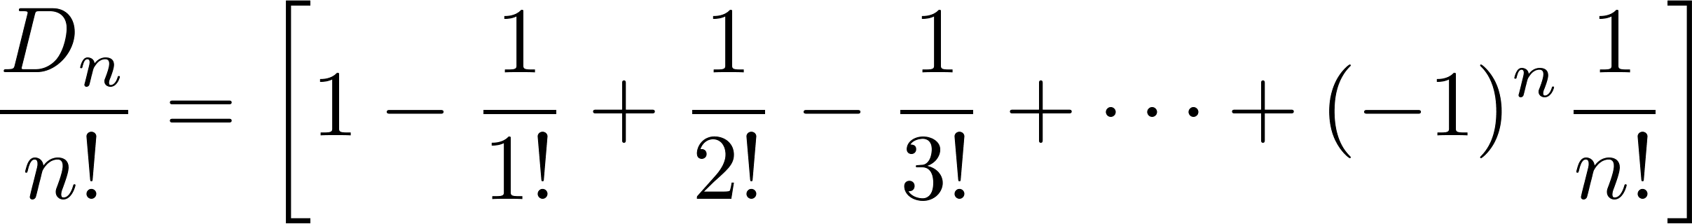
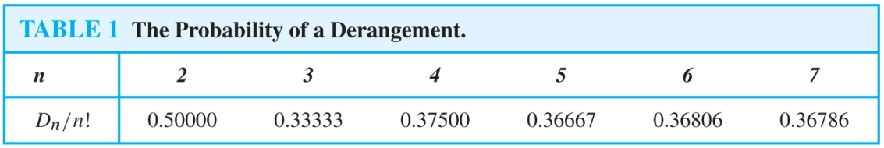
Example
The Hatcheck Problem: A new employee checks the hats of n people at restaurant, forgetting to put claim check numbers on the hats.
When customers return for their hats, the checker gives them back hats chosen at random from the remaining hats.
What is the chance that no one receives the correct hat?
The number of ways the hats can be arranged so that there is no hat in its original position divided by n!, the number of permutations of n hats.

Slide 65
Summary
Principle of Inclusion-Exclusion for 2 sets
Principle of Inclusion-Exclusion for 3 sets
Principle of Inclusion-Exclusion for n sets
Number of Derangements

